Slide 1
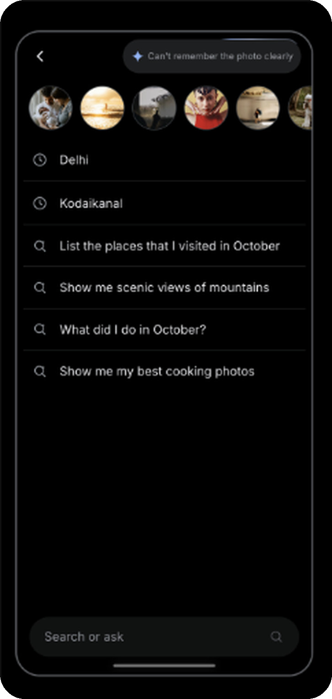
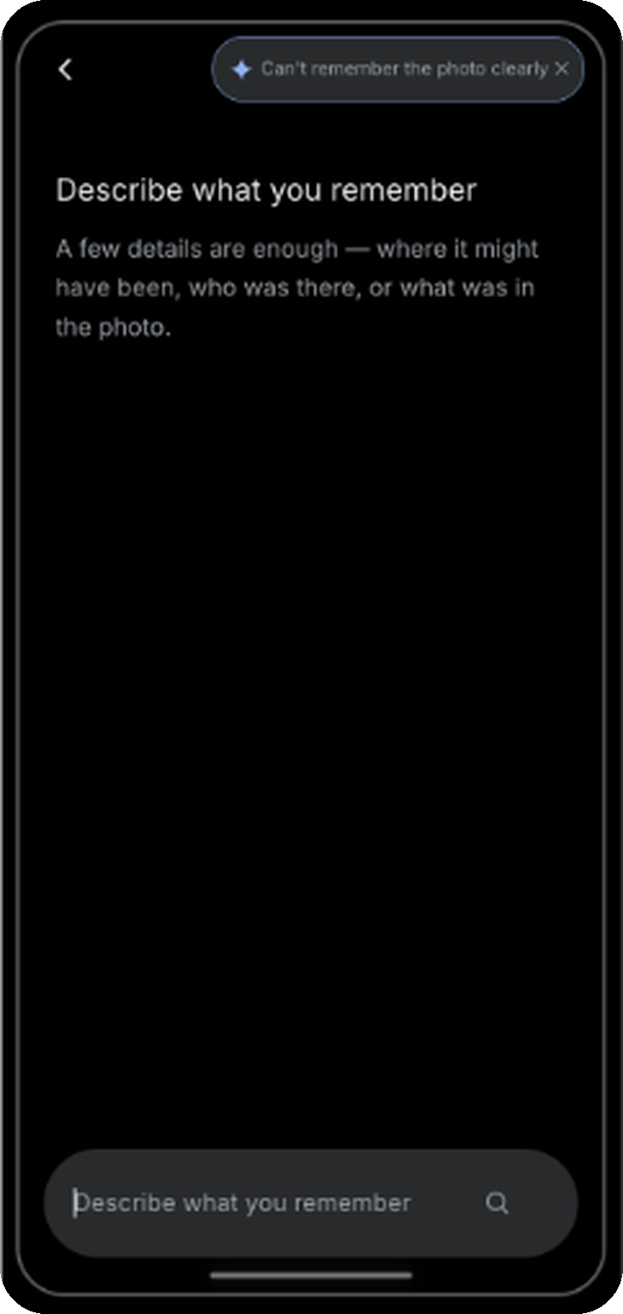
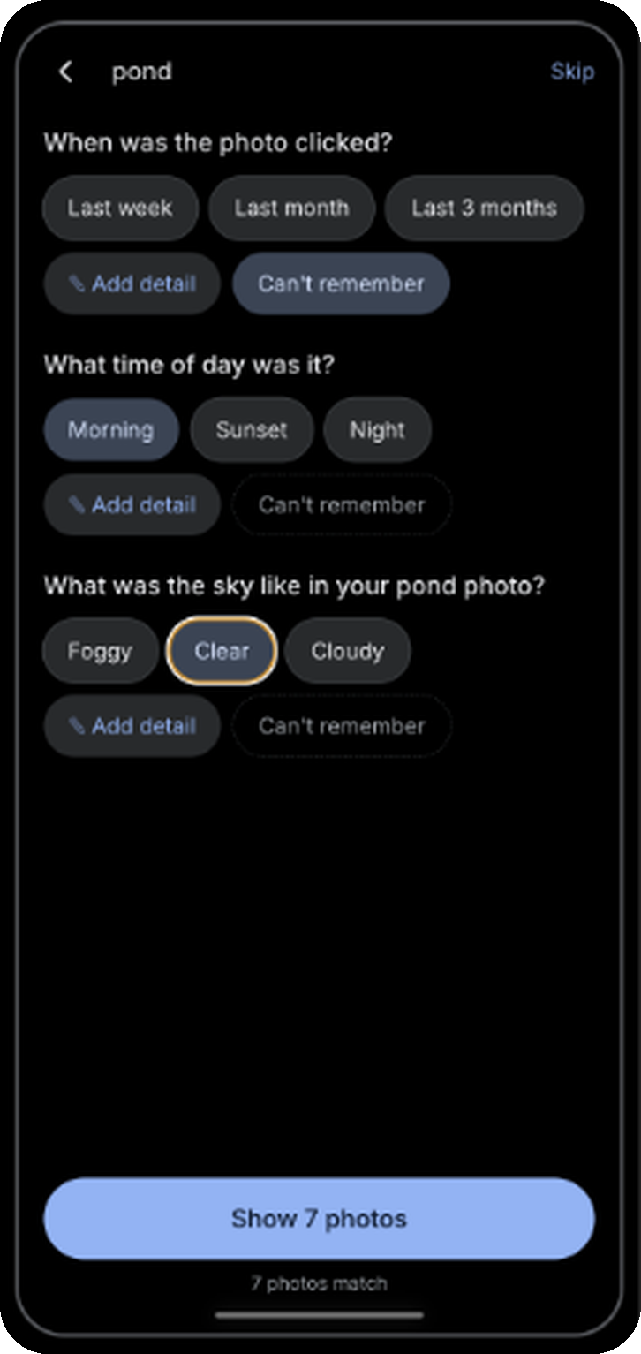
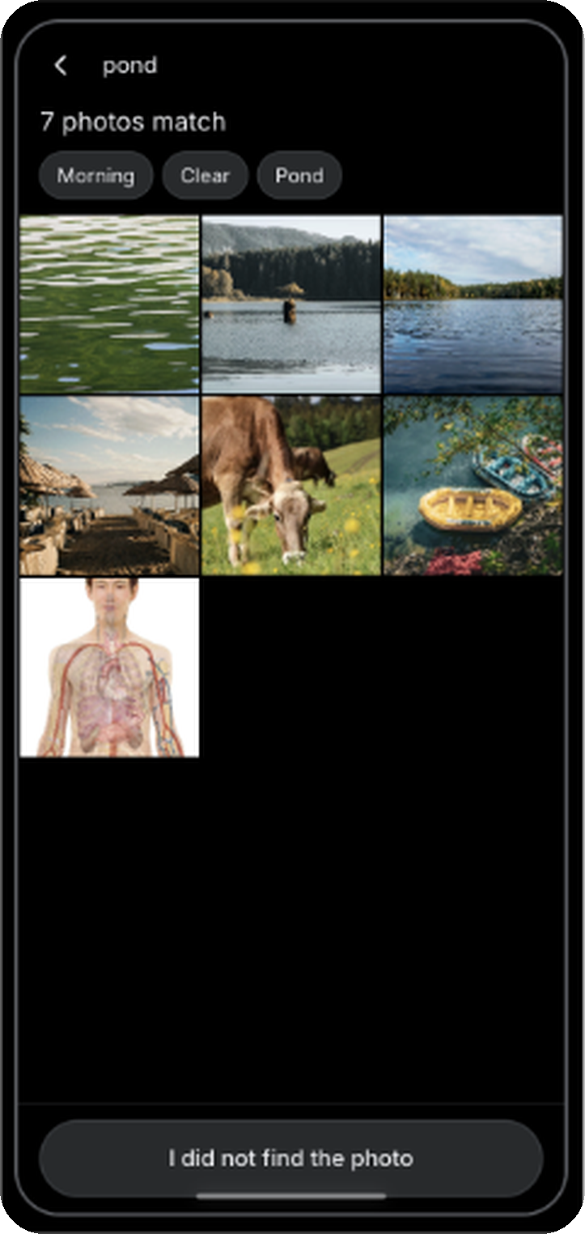

Guided questions turn a vague memory into a found photo
Intent Clarifier user journey: one tap per question, with a safety net when the first try fails
1
DISCOVER
2
DESCRIBE
3
ANSWER
4
REFINE
5
RECOVER
Tap “Can't remember the photo clearly”
Type whatever you remember
Answer guided questions with one tap
Tap “I did not find the photo”
Start fresh or search by place
›
›
›
›
A small animated nudge in the top bar makes the entry point easy to spot.
One word is enough. This gives us the first intent signal.
Three questions at a time help users dissect their memory, one tap each.
A new round of different questions adds data points to narrow further.
Hand-holding continues after repeated misses, so users never hit a dead end.
5/6 users struggled to recall place photos
6/6 users typed two words or fewer
33% of successful retrievals needed heavy scrolling
3 of 5 failed searches stayed unsuccessful
Goal: lower average query refinement rate
Notes:
Journey: (1) Tap the 'Can't remember the photo clearly' chip in the top bar. (2) Type what you remember, even one word. (3) Answer three guided questions at a time with one tap each; optional detail per question. (4) If the photo is not in the results, tap 'I did not find the photo' for a fresh round of different questions. (5) After repeated misses, start fresh or search by place. Evidence chips come from the user research findings: 5/6 least recalled place photos; 6/6 typed two words or fewer; 33% of successful retrievals needed heavy scrolling; 3 of 5 initial failures stayed unsuccessful. Goal metric: reduction in average query refinement rate in AI Search.

